Slide 1
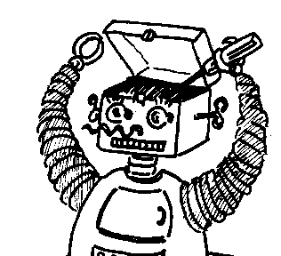
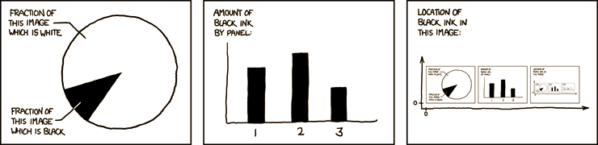

Maryland Metacognition Seminar
http://xkcd.com/
Monitoring cognitive processes during reading: Is there converging evidence from fMRI studies of metacognitive control?
Linda Baker
Department of Psychology, University of Maryland, Baltimore County
10 MAY 2013, 12:00 PM
Biology/Psychology Bldg., RM. 1124, College Park
Abstract:
The important role of metacognition in the development and use of academic skills is widely recognized in educational research and practice. In the domain of reading, the most important metacognitive skill is comprehension monitoring, the evaluation and regulation of comprehension. Readers who monitor their understanding realize when they have encountered difficulty making sense of the text, and they apply error correction procedures to attempt to resolve the difficulty. Research has documented that although even young children have some capability in monitoring their comprehension, these executive control skills continue to develop into the adult years. Research to date has not examined neural correlates of comprehension monitoring, but related research on discourse processing and executive function suggests that neuroimaging studies will yield valuable information. In this presentation, I will discuss the background, rationale, and methods of a new study designed to examine brain functioning while college students engage in reading tasks requiring them to monitor their cognitive processes and to examine individual differences in brain activation patterns in relation to reading skill and self-regulated learning strategies (including motivation and metacognition).

